Slide 1

PSR-JCB Construction Webinar
November 30th, 2020

Slide 2

PSR-JCB Construction Industry Trends Webinar
Global Market Research
industry data & forecasting
Utilized by engine manufacturers, OEMs, component and parts suppliers, associations, financial analysts, publications and more.
JCB is one of the world’s largest construction equipment brand by volume, It produces a wide range of construction equipment including its own engines. It is family owned and this year celebrated is 75th Anniversary.

Slide 3





PSR-JCB Construction Industry Trends Webinar

Slide 4
PSR-JCB Construction Industry Trends Webinar Agenda
Propulsion Solutions for The Construction Industry
Daniel Jackson, JCB Power Systems Ltd, OEM Engine Sales and Applications Manager
Europe Construction Forecast.
Christopher Bamforth, Power Systems Research – European Market Analyst
North & South America Construction Forecast.
Lorena Violante, Power Systems Research – Senior Market Research Consultant
Q&A.
Emiliano Marzoli, Power Systems Research – European Operations Manager

Slide 5

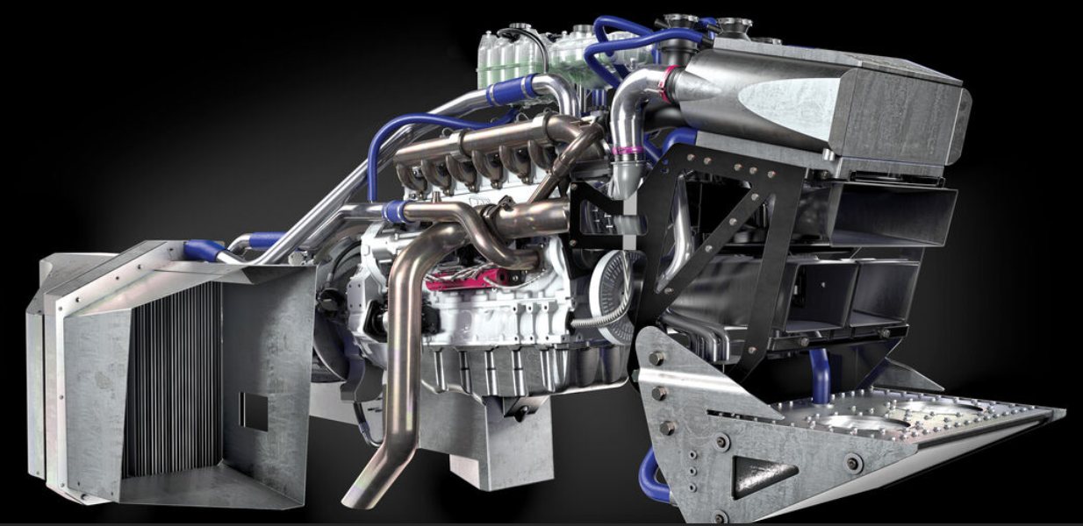
Agenda
Who we are?
COVID-19
EU Markets
NA/SA Markets
Propulsion Solutions
Operational Solutions

Slide 6
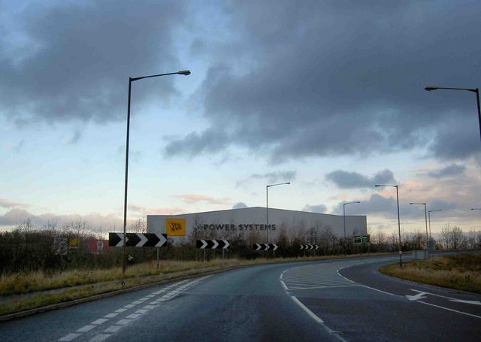



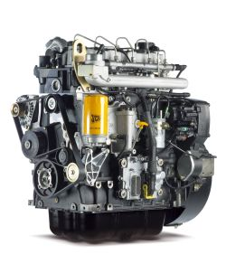

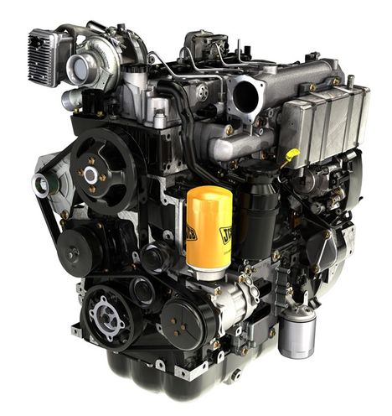
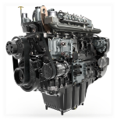
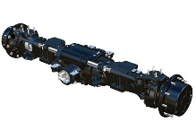
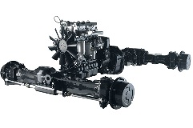
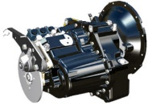
The JCB Engine Story
2009 - OEM Sales Commenced
A Father’s Dream
A Son’s Reality
2004
2006
2008
2010
2012
2014
2000
2016
2017
2018
2002
2019
2020
Start of ‘444’ engine program
Launch T2 Mech.
Launch T3 Common Rail
Launch BS3
Launch 6 Cylinder
400,000th engine
430 engine launch
+56kW Stage V
Launch T3 Mech.
Launch T4i
Launch T4f
Open JCB Machining center
#WFT 150mph
Complete Propulsion Solution

Slide 7

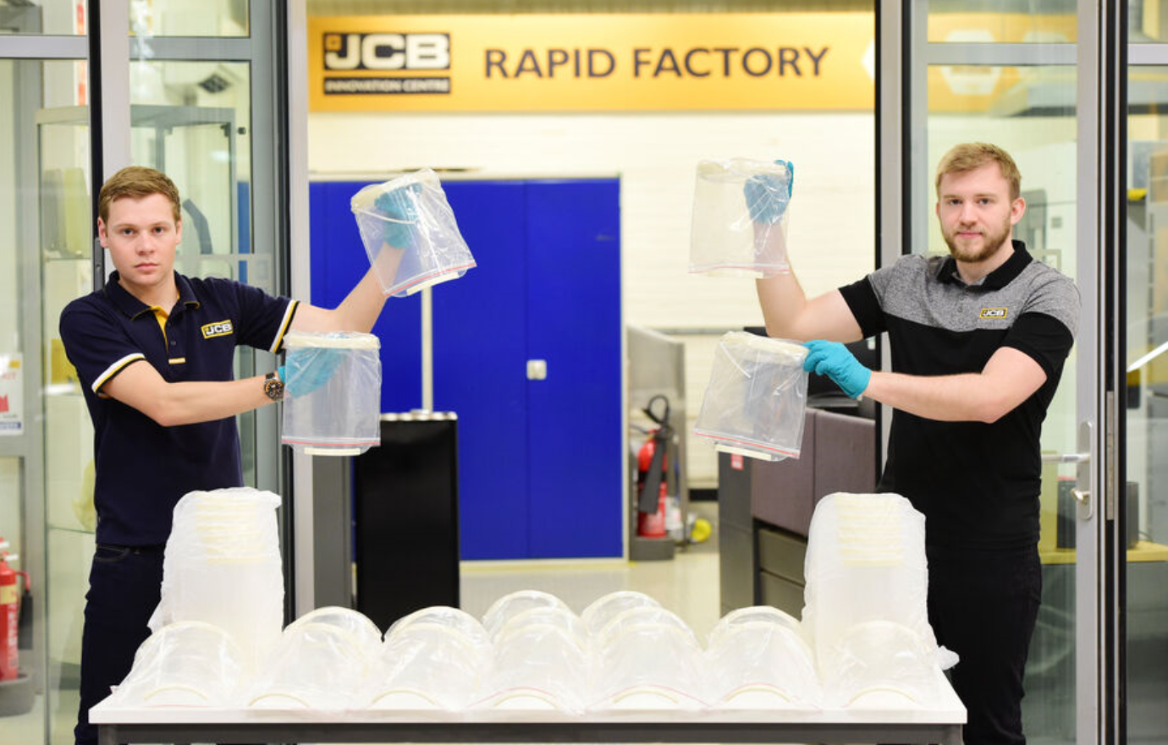

COVID-19
Effects
        Every level
        Structure and process
        Still ongoing
Actions
        Safe working practices
        Reductions and efficiency
        External help
Outcomes
        Need for data
        Respond in the right way
        Solution providers & partnerships
Future and lessons learnt
        The new face to face
        Engineering support
        Telematics
        Ability to respond

Slide 8


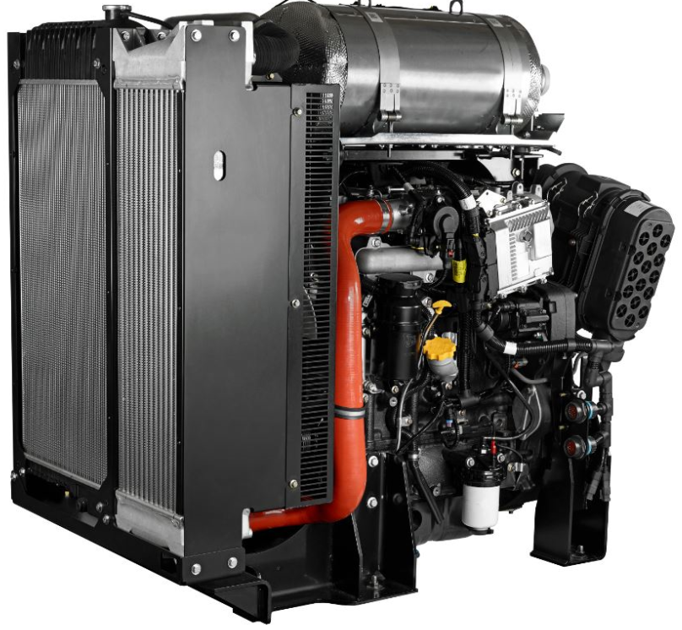
European Engine Market
Brexit
      No deal likely
      Be ready
      Tariffs
Stage V
      Main development driver
      DPF standard
      Selection is key
Driver for Alternative Fuels
      At the centre of development
      Plenty of option, no single solution for all
Stage V uptake for GDrive
      Commodity market
Flexible, complete solutions
      Control and functionality focus
      Engine manufactures support

Slide 9

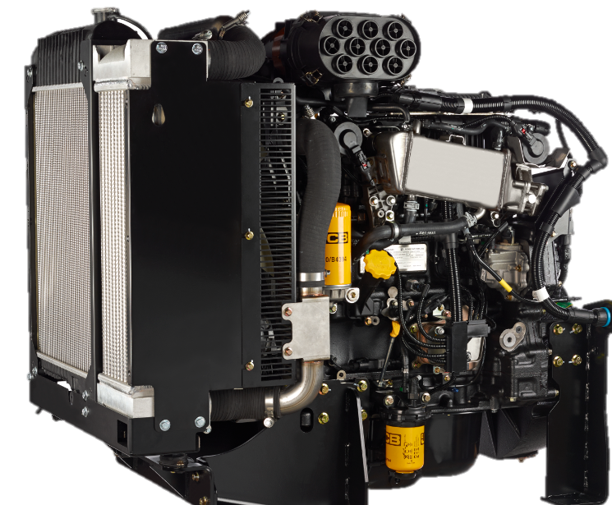
NA/SA Engine Markets
Tier 4 now - Tier 5?
      Technology is well known
      New administration on the way – Effects?
S/A - very different
      Instability
      Need in-country manufacture
      Lower technology requirements
      Fuel quality and infrastructure
Spark Ignition
      Prominent use
      Lower cost and route to LPG and CNG
Continued growth
      Large growth market
      Power gen need
      Local tender driving fleet updates
Specific products
      Development of EPA/CARB certified

Slide 10
Propulsion Solutions
Sustainable solutions
      Most are in the race
      Expectation for production
Biggest development driver after emission compliance
      Focus shift from Emission compliance
      Different applications, different solutions
No one size fits all
      Natural fits
      Further development for higher power nodes
      Integration support and design partnerships
More than just an engine change
      Need to be robust and sustainable
      Diesel is not dead
Which Solution?
Gas
Electric
Hydrogen
Hybrid
Alternative Fuels
Diesel
Gasoline

Slide 11


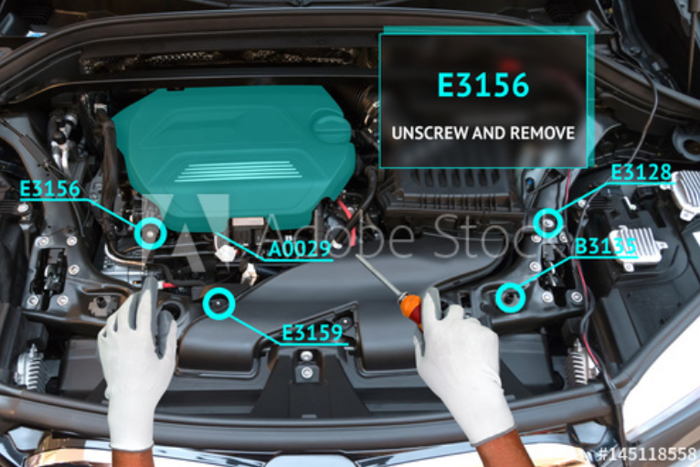
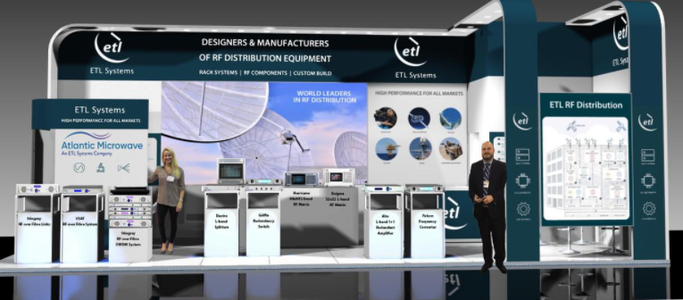
Operational Solutions
Video conferencing
    Here to stay
Telematics
    Essential engine data
    Better support
Augmented Reality –AR
    Better interface
    Sales benefits
Virtual exhibitions
    Virtual access
    Cost reduction

Slide 12
Summary
COVID is ongoing - effects causing review of operational processes and structure
EU market driving alternatives, North America providing growth and South America maintaining lower technology solutions
Alternatives race is on, no one size fits all and application dependant. Infrastructure will be key along with integration support
Video conferencing and virtual exhibitions are become the norm. Use of technology to support product selection and service
Exciting time, while diesel is not dead, focus is on removing the true source of emissions in Off Highway sector. A future of Powerful Possibilities.

Slide 13
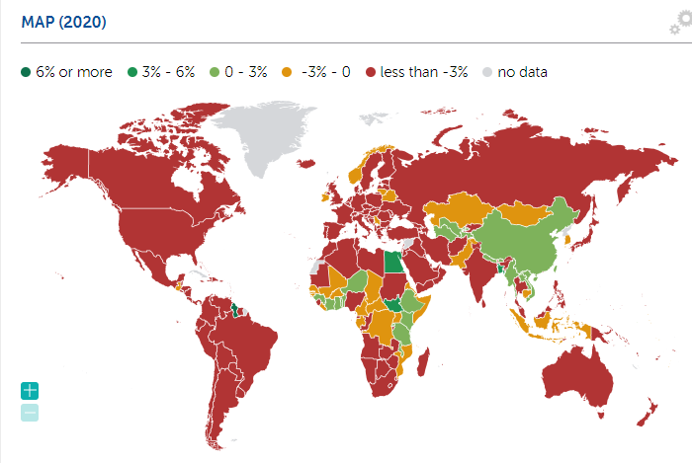
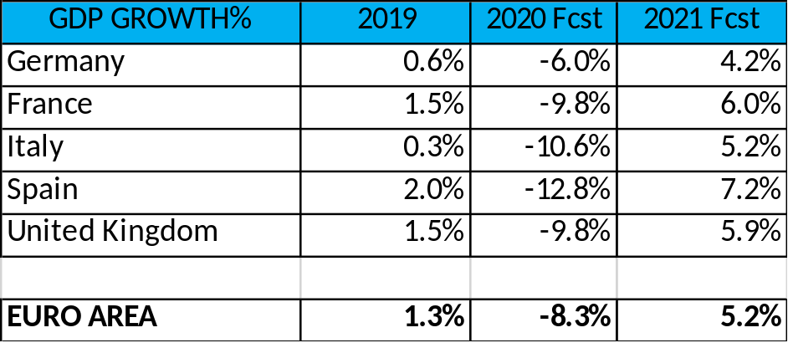
Europe – Economic Outlook
-8.3%
COVID 2nd wave - 2020 slow recovery
2021 won´t reach 2019 levels
European Parliament and EU countries - recovery plan and stimulus package (€15 billion)
Early debates on EU leveling the playing field for foreign subsidies
Uncertainty; Brexit – US elections
Source: IMF.com

Slide 14

Europe – Construction Industry Outlook
Construction machinery was very strong and was expected to continue growing pre-crisis
Companies focused on cutting cost and increase liquidity
Construction 2020: -20% vs 2019
2021: -10% to -15% vs 2019
Eastern Europe performance remains poor; Western Europe tougher situation (Italy, France, and Spain)

Slide 15

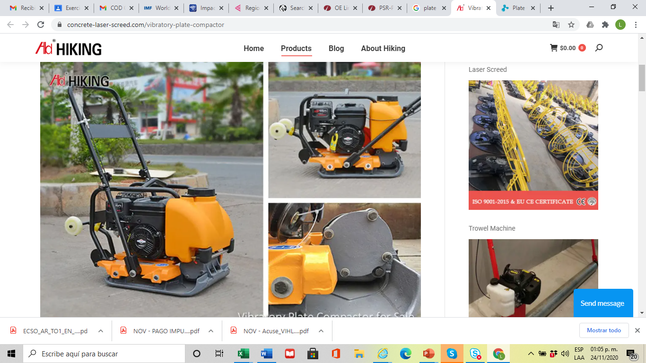

Europe – Construction Equipment
Top Construction Equipment Produced:
Excavators
Plate Compactors
Wheel Loaders
Production volume (units)
Source: OLink™ Production – Forecast Database

Slide 16
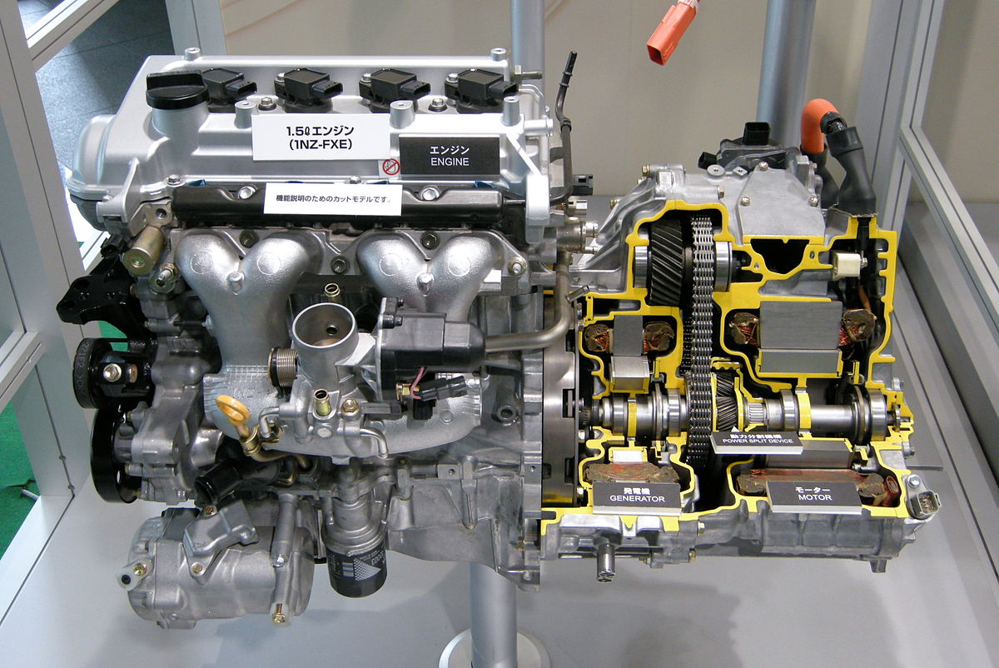
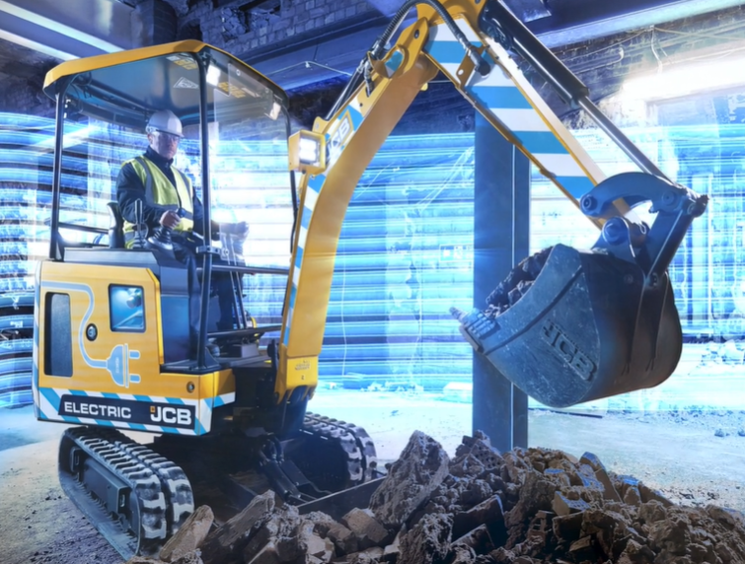
Europe – Construction Alternate Drives
Small applications → electric
Larger applications → alternative fuels
Real world prototype testing
Government, institutions, OEMs working together
Hybrid
JCB 19C-1E Electric Mini Excavator

Slide 17
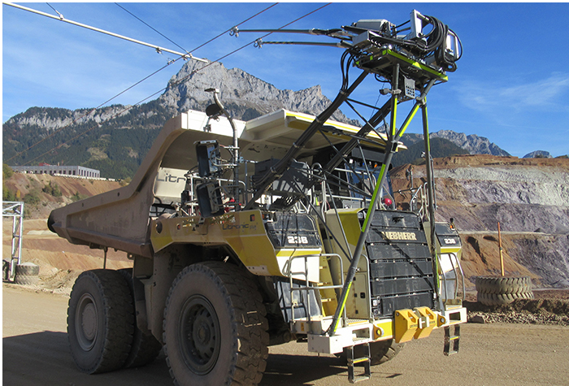
Europe – OEM Happenings
Wacker Neuson
  Zero emissions focus
JCB
    Mini electrics
    Long standing customers
Caterpillar
    First elevated sprocket electric drive
    Tough 3rd quarter
Atlas Copco
  Held an extraordinary general meeting for all shareholders
Liebherr
    New generation dump trucks Stg V
    Partnership with VA Erzberg
  Volvo
    Very good Q3 orders intake up 40%
    Launch of new F generation
    Early adoption of autonomous transport

Slide 18
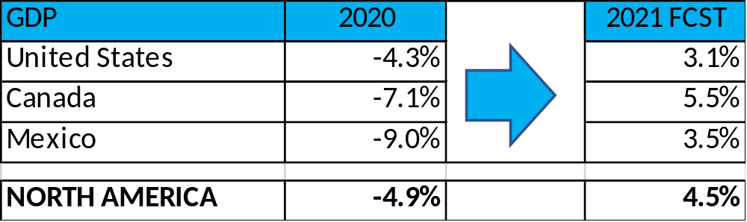
North America – Economic Outlook
U-Shaped economic recovery - slow
COVID-19 gradual control
Governments economic stimulus programs vary
  U.S. $2.2 trillion stimulus package
  Canada $2.2 Bill businesses; $5.8 Bill health
  Mexico 0.2% GDP (healthcare) 0.5% GDP (businesses & households)
-4.9%
Source: IMF.com

Slide 19
North America – Construction Industry Outlook
Governments bids and infrastructure investments on hold/cancelled
Construction is an essential sector for economic health
  Lockdowns not at 100%
  New ways of working
Canada: weak, non-residential -8.5% residential +1.6%; recovery by 2023
U. S. : down by 8% ; recovery by 2023
Mexico: down by 19%; uncertainty and no expected growth

Slide 20

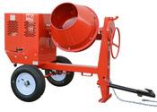
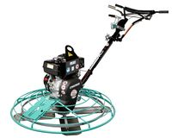
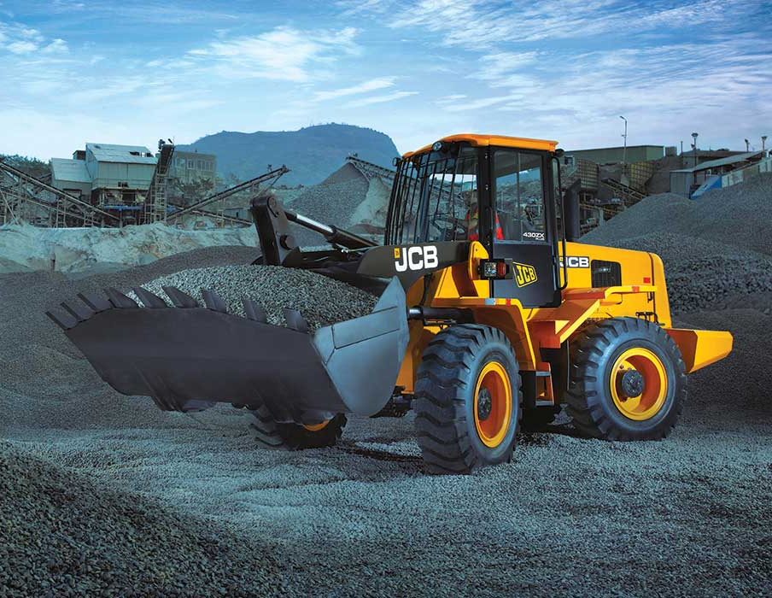
North America – Construction Equipment
Top Construction Equipment Produced:
Skid Steer Loaders
Mixers
Finishing Equipment
Wheel Loaders
Production volume (units)
Source: OE Link™ Production – Forecast Database

Slide 21
North America – Construction Alternate Drives
Today´s alternative drives: diesel, gasoline, LPG
Key drivers: emission and noise regulations, TCO, pollution
OEM challenges:
  Understand customer needs
  End users understanding benefits
  Offer a complete alternate drives range
IC: HD / MD / Small equipment
Hybrid: MD equipment
Electric: Small equipment
Hybrid
JCB 19C-1E Electric Mini Excavator

Slide 22
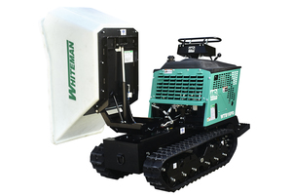
North America – OEM Happenings
Caterpillar
  Q3 Revenue -23%
  Strong balance sheet position
  Supporting customers during pandemic
Bobcat
  WW Leader compact equipment
  Next is now: new technology
Deere
  All U.S. production facilities operating
  2020 full year revenue -9%
  2020 Q4.5% above 2019 Q4
Multiquip
  Small equipment
  Prescence NA, SA, Europe, Asia
  Track-drive Power Buggy with pivot dump

Slide 23
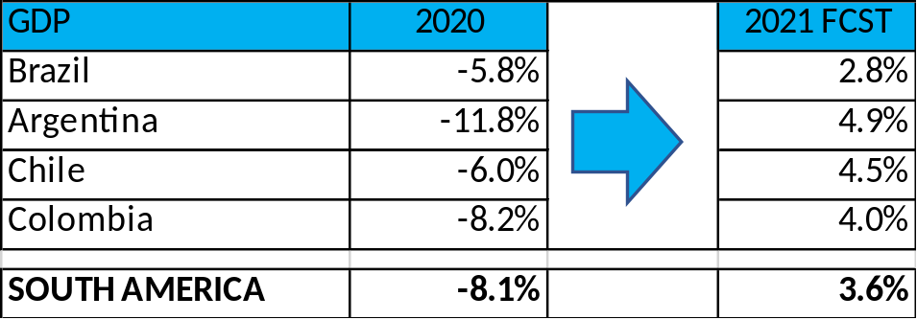
South America – Economic Outlook
-9%
U-Shaped economic recovery – strong slowdown
COVID-19 gradual control
Governments assigned an economic stimulus package
IMF – Emergency financial support to 17 countries (US $5.2 bill)
-8.1%
Source: IMF.com

Slide 24
South America – Construction Industry Outlook
Brazil
  Most projects remain in progress (88%)
  Only producer in the region – exports slight fall
  Some bidding projects approved
Argentina
  Contraction by 23.5% in 2020, -5.4% in 2021
  Difficult economic conditions before COVID
Chile
  Industry to decrease by 7.7% in 2020
  Lost jobs – 40,000
Colombia
  Slowdown (-8.6%)
  Recovery key to reactivate economy

Slide 25

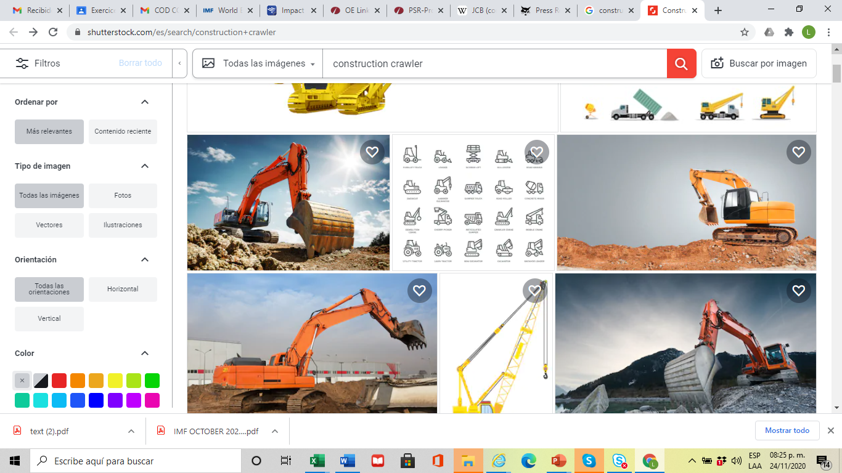
South America – Construction Equipment
Top Construction Equipment Produced:
Tractor/Loader/Backhoes
Wheel Loaders and Dozers
Crawlers
Production volume (units)
Source: OE Link™ Production – Forecast Database

Slide 26
South America – Construction Alternate Drives
Alternative drives: IC only (diesel, gasoline)
Emission regulations not mandatory
No other alternate drives produced or imported in the region
OEMs challenge:
  Understand customer needs on alternate drives
Hybrid
JCB 19C-1E Electric Mini Excavator

Slide 27
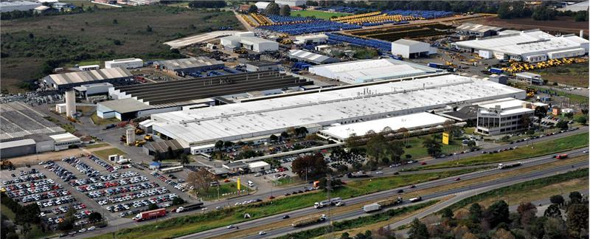
South America – OEM Happenings
Caterpillar
  6 manufacturing sites
  1 distribution center
  5,000 employees
CNH
  1 manufactuting site
  1,800 employees
  Ag and Construction equipment
Komatsu
  4 manufacturing sites
  Aprox. 500 employees
Volvo
  1 manufacturing site
  340 employees

Slide 28

Powerful expertise, innovation for the future
THANKS!
Q&A

Slide 29
Power Systems Research – Global Offices and Affiliates*
Power Systems Research, Inc.
World Headquarters
St. Paul, MN USA
info@powersys.com
Power Systems Research SA
European Headquarters
Brussels, BELGIUM
infobr@powersys.com
Power Systems Research (Beijing) Co., Ltd.
Beijing, CHINA
infocn@powersys.com
Power Systems Research, Inc.
Detroit Regional Office
Ann Arbor, MI USA
infode@powersys.com
PSR Power Systems Research India Pvt. Ltd.
Pune, INDIA
infoin@powersys.com
Power Systems Research
Far East / SE Asia Research
Tokyo, JAPAN
infojp@powersys.com
Power Systems Research*
Campinas, BRAZIL
infosa@powersys.com
Power Systems Research*
Moscow, RUSSIA
inforu@powersys.com
Tohan Research, Inc.*
Tokyo, JAPAN
infojp@powersys.com
www.powersys.com

